Slide 1
Revert command
Group 10
Shubham Singh Rawat, Shivam Pateriya, Shubham Sharm & Hardik Talwar

Slide 2
Git Revert
the git revert consider as an 'undo' type command
it figure out how to invert the changes introduced by the commit and appends a new commit with the result inverse content

Slide 3
Advantage
git revert prevent Git from losing history.
maintain the integrity revision history.
Maintain the integrity of reliable collaboration.

Slide 4
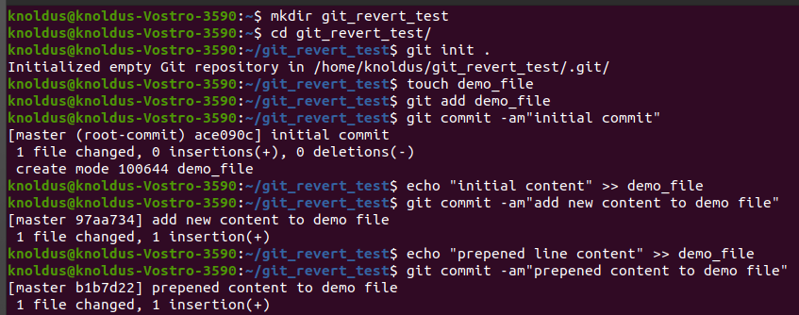
Example

Slide 5
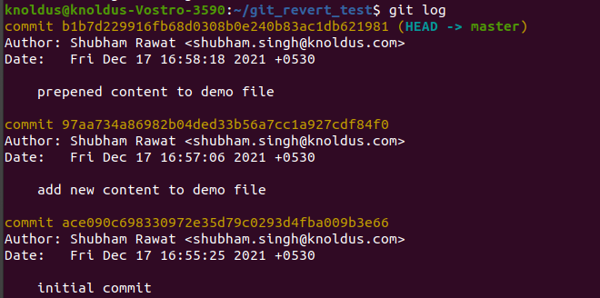
Example continue..

Slide 6
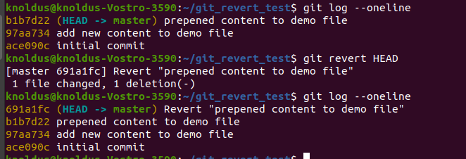
Example continue..

